Slide 1
SAAS proposal
· SAAS PROPOSAL · SAAS PROPOSAL · SAAS PROPOSAL · SAAS PROPOSAL · SAAS PROPOSAL · SAAS PROPOSAL · SAAS PROPOSAL · SAAS PROPOSAL · SAAS PROPOSAL · SAAS PROPOSAL · SAAS PROPOSAL · SAAS PROPOSAL ·
SAAS
SAAS PROPOSAL · SAAS PROPOSAL · SAAS PROPOSAL · SAAS PROPOSAL · SAAS PROPOSAL · SAAS PROPOSAL · SAAS PROPOSAL
SAAS PROPOSAL · SAAS PROPOSAL · SAAS PROPOSAL · SAAS PROPOSAL · SAAS PROPOSAL · SAAS PROPOSAL · SAAS PROPOSAL
Built by students for students
· SALES PROPOSAL · SALES PROPOSAL · SALES PROPOSAL · SALES PROPOSAL · SALES PROPOSAL · SALES PROPOSAL · SALES PROPOSAL · SALES PROPOSAL · SALES PROPOSAL · SALES PROPOSAL · SALES PROPOSAL · SALES PROPOSAL ·

Slide 2
About the project
Major features
Project goals
- TABLE OF CONTENTS -
- TABLE OF CONTENTS -
Sneak peek
Project stages
Our team
1
2
3
A SAAS direct student marketing solution
An engaging solution for brands via SubBoxes
Discounted online student catalogue
4
5
6
For students across all disciplines
Site wide requirements front and back end
Meet the team behind the project so far

Slide 3
- OUR COMPANY -
- OUR COMPANY -
Student Survival Box
Filling a gap in the market for an engaging and highly discounted commerce and marketing solution for brands to market directly to students via, subscription box packages, products listed in online catalogue, direct email marketing and through social media.

Slide 4
About the
· ABOUT THE PROJECT · ABOUT THE PROJECT · ABOUT THE PROJECT · ABOUT THE PROJECT · ABOUT THE PROJECT · ABOUT THE PROJECT · ABOUT THE PROJECT · ABOUT THE PROJECT · ABOUT THE PROJECT · ABOUT THE PROJECT ·
1
Currently there is no platform that exists targeting students or leading direct product marketing campaigns in an agency style
· ABOUT THE PROJECT · ABOUT PROJECT · ABOUT THE PROJECT · ABOUT PROJECT · ABOUT THE PROJECT · ABOUT PROJECT ·
· ABOUT THE PROJECT · ABOUT PROJECT · ABOUT THE PROJECT · ABOUT PROJECT · ABOUT THE PROJECT · ABOUT PROJECT ·
project
· ABOUT THE PROJECT · ABOUT THE PROJECT · ABOUT THE PROJECT · ABOUT THE PROJECT · ABOUT THE PROJECT · ABOUT THE PROJECT · ABOUT THE PROJECT · ABOUT THE PROJECT · ABOUT THE PROJECT · ABOUT THE PROJECT ·

Slide 5
- ABOUT THE PROJECT -
- ABOUT THE PROJECT -
Used by brands for an array of business practices whether that is for pre-launch analysis/survey, user generated content, product marketing or brand awareness.

Slide 6
Marketing styled deliverables
· ABOUT THE PROJECT · ABOUT THE PROJECT · ABOUT THE PROJECT · ABOUT THE PROJECT · ABOUT THE PROJECT · ABOUT THE PROJECT · ABOUT THE PROJECT · ABOUT THE PROJECT · ABOUT THE PROJECT · ABOUT THE PROJECT ·
Creating a complete and comprehensive suite of marketing services while delivering a high-quality product to students at a low cost and embedding the site with all higher level educational providers both online and on campus to lead the way as one of the best known brands to this audience
· ABOUT THE PROJECT · ABOUT PROJECT · ABOUT THE PROJECT · ABOUT PROJECT · ABOUT THE PROJECT · ABOUT PROJECT ·
· ABOUT THE PROJECT · ABOUT PROJECT · ABOUT THE PROJECT · ABOUT PROJECT · ABOUT THE PROJECT · ABOUT PROJECT ·
· ABOUT THE PROJECT · ABOUT THE PROJECT · ABOUT THE PROJECT · ABOUT THE PROJECT · ABOUT THE PROJECT · ABOUT THE PROJECT · ABOUT THE PROJECT · ABOUT THE PROJECT · ABOUT THE PROJECT · ABOUT THE PROJECT ·

Slide 7
major features
· MAJOR PROTOCOL · MAJOR PROTOCOL · MAJOR PROTOCOL · MAJOR PROTOCOL · MAJOR PROTOCOL · MAJOR PROTOCOL · MAJOR PROTOCOL · MAJOR PROTOCOL · MAJOR PROTOCOL · MAJOR PROTOCOL · MAJOR PROTOCOL ·
HTML, CSS Tailwinds, React (pReact) Node.js and MySQL
2
· MAJOR PROTOCOL · MAJOR PROTOCOL · MAJOR PROTOCOL · MAJOR PROTOCOL · MAJOR PROTOCOL · MAJOR PROTOCOL ·
· MAJOR PROTOCOL · MAJOR PROTOCOL · MAJOR PROTOCOL · MAJOR PROTOCOL · MAJOR PROTOCOL · MAJOR PROTOCOL ·
· MAJOR PROTOCOL · MAJOR PROTOCOL · MAJOR PROTOCOL · MAJOR PROTOCOL · MAJOR PROTOCOL · MAJOR PROTOCOL · MAJOR PROTOCOL · MAJOR PROTOCOL · MAJOR PROTOCOL · MAJOR PROTOCOL · MAJOR PROTOCOL ·

Slide 8
What we are working on
- WHAT WE ARE WORKING ON -
- WHAT WE ARE WORKING ON -
retail
Generating direct slaes through an online catagloue srocked with partner brand products and services
Creating a new product within the student marketing sector that will allow brands to promote their products in front of an entire network of students
Within the user dashboard the customer will be able to leave a review and rate each individual product they receive and submit a photo of themselves with the product if they wish
subscription
User generated content

Slide 9
Revenue Streams
- SNEAK PEEK -
- SNEAK PEEK -
SubBox
Online Sales
Review Generation
Monthly Subscriptions
Direct partner product sales
Paid feedback from poducts included in subscription boxes
UGC Creation
Print Marketing
Social First
Paid customer content from products included in subscription boxes
Paid materials added into subscription boxes and direct sales
Paid social media advertising, on web, socials and via email

Slide 10
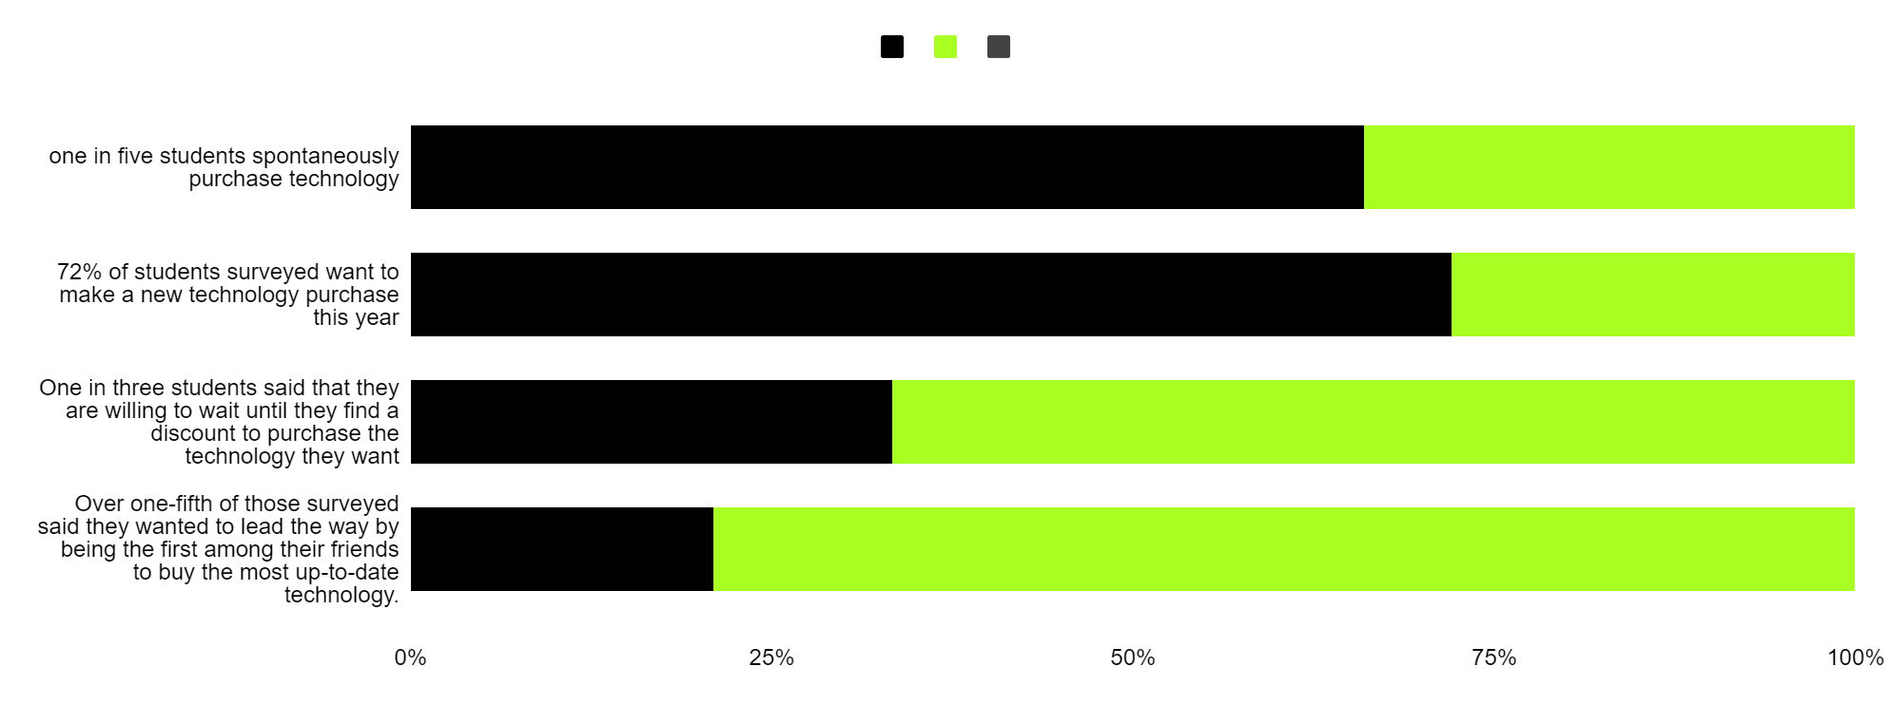
Student Findings
- ANALYSIS -
- ANALYSIS -
100%
5,000
75%
50%
A new report by UNiDAYS reveals how students buy their tech - including researching online, the amount they spend and the main drivers behind their purchases.
One in three students said that they are willing to wait until they find a discount to purchase the technology they want
Over one-fifth of those surveyed said they wanted to lead the way by being the first among their friends to buy the most up-to-date technology.
72% of students surveyed want to make a new technology purchase this year
one in five students spontaneously purchase technology
25%
0%
PURCHASE
NEW TECH
DISCOUNT
FIRST

Slide 11
Subscription Box
385
- PROJECT GOALS -
- PROJECT GOALS -
5,
Students enrolled at Falmouth University

Slide 12
If
10%
- PROJECT GOALS -
- PROJECT GOALS -
Of the students on campus subscribed to a monthly box

Slide 13
Per box
£15
- PROJECT GOALS -
- PROJECT GOALS -
A standard price point for the marketplace

Slide 14
Startup
085
- PROJECT GOALS -
- PROJECT GOALS -
£8,
In monthly revenue from one service

Slide 15
Any
· ABOUT THE PROJECT · ABOUT PROJECT · ABOUT THE PROJECT · ABOUT PROJECT · ABOUT THE PROJECT · ABOUT PROJECT ·· ABOUT THE PROJECT · ABOUT PROJECT · ABOUT THE PROJECT · ABOUT PROJECT · ABOUT THE PROJECT ·
· ABOUT THE PROJECT · ABOUT PROJECT · ABOUT THE PROJECT · ABOUT PROJECT · ABOUT THE PROJECT · ABOUT PROJECT ·
· ABOUT THE PROJECT · ABOUT PROJECT · ABOUT THE PROJECT · ABOUT PROJECT · ABOUT THE PROJECT · ABOUT PROJECT ·
Questions?
· ABOUT THE PROJECT · ABOUT PROJECT · ABOUT THE PROJECT · ABOUT PROJECT · ABOUT THE PROJECT · ABOUT PROJECT ·· ABOUT THE PROJECT · ABOUT PROJECT · ABOUT THE PROJECT · ABOUT PROJECT · ABOUT THE PROJECT ·

Slide 16
project
· PROJECT GOALS · PROJECT GOALS · PROJECT GOALS · PROJECT GOALS · PROJECT GOALS · PROJECT GOALS · PROJECT GOALS · PROJECT GOALS · PROJECT GOALS · PROJECT GOALS · PROJECT GOALS · PROJECT GOALS · PROJECT GOALS ·
3
Accessible for any students in education at a higher level only across the UK
· PROJECT GOALS · PROJECT GOALS · PROJECT GOALS · PROJECT GOALS · PROJECT GOALS · PROJECT GOALS · PROJECT ·
· PROJECT GOALS · PROJECT GOALS · PROJECT GOALS · PROJECT GOALS · PROJECT GOALS · PROJECT GOALS · PROJECT ·
goals
A similar rollout to that of Facebook’s initial MVP
· PROJECT GOALS · PROJECT GOALS · PROJECT GOALS · PROJECT GOALS · PROJECT GOALS · PROJECT GOALS · PROJECT GOALS · PROJECT GOALS · PROJECT GOALS · PROJECT GOALS · PROJECT GOALS · PROJECT GOALS · PROJECT GOALS ·

Slide 17
Project Goals
- GOALS -
- GOALS -
Creating a completely seamless experience and trustwothy brand for students with a concentration on discounts/savings and high product quality.
Putting students first

Slide 18
sneak peek
· SNEAK PEEK · SNEAK PEEK · SNEAK PEEK · SNEAK PEEK · SNEAK PEEK · SNEAK PEEK · SNEAK PEEK · SNEAK PEEK · SNEAK PEEK · SNEAK PEEK · SNEAK PEEK · SNEAK PEEK · SNEAK PEEK · SNEAK PEEK · SNEAK PEEK · SNEAK PEEK · SNEAK PEEK ·
Proposed branding and user interface; dashboard wireframes
4
· SNEAK PEEK · SNEAK PEEK · SNEAK PEEK · SNEAK PEEK · SNEAK PEEK · SNEAK PEEK · SNEAK PEEK · SNEAK PEEK · SNEAK PEEK ·
· SNEAK PEEK · SNEAK PEEK · SNEAK PEEK · SNEAK PEEK · SNEAK PEEK · SNEAK PEEK · SNEAK PEEK · SNEAK PEEK · SNEAK PEEK ·
· SNEAK PEEK · SNEAK PEEK · SNEAK PEEK · SNEAK PEEK · SNEAK PEEK · SNEAK PEEK · SNEAK PEEK · SNEAK PEEK · SNEAK PEEK · SNEAK PEEK · SNEAK PEEK · SNEAK PEEK · SNEAK PEEK · SNEAK PEEK · SNEAK PEEK · SNEAK PEEK · SNEAK PEEK ·

Slide 19
- SNEAK PEAK -
- SNEAK PEAK -
Branding and Identity
This is the colour scheme and conception identity for the platform
Bebas Neue
#000000
#ffffffff
#a9ff22
#434343

Slide 20
- SNEAK PEEK -
- SNEAK PEEK -
logotype

Slide 21


- SNEAK PEEK -
- SNEAK PEEK -
favicon
V1
V2

Slide 22
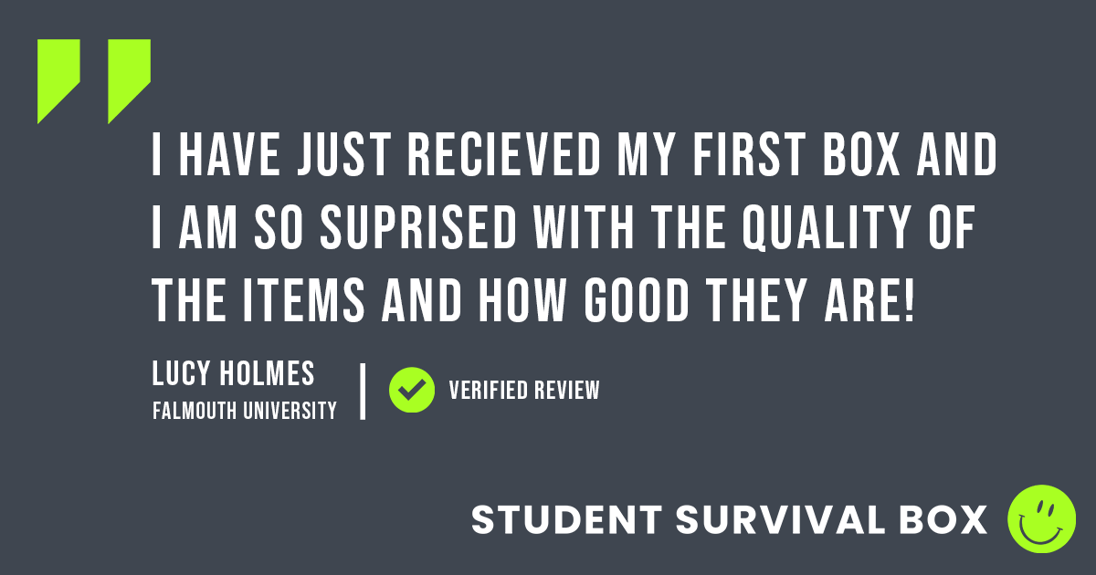
- SNEAK PEEK -
- SNEAK PEEK -
OpenGraph Image

Slide 23

Direct access to one of the most lucrative markets for brands
- SNEAK PEEK -
- SNEAK PEEK -
sneak peek

Slide 24
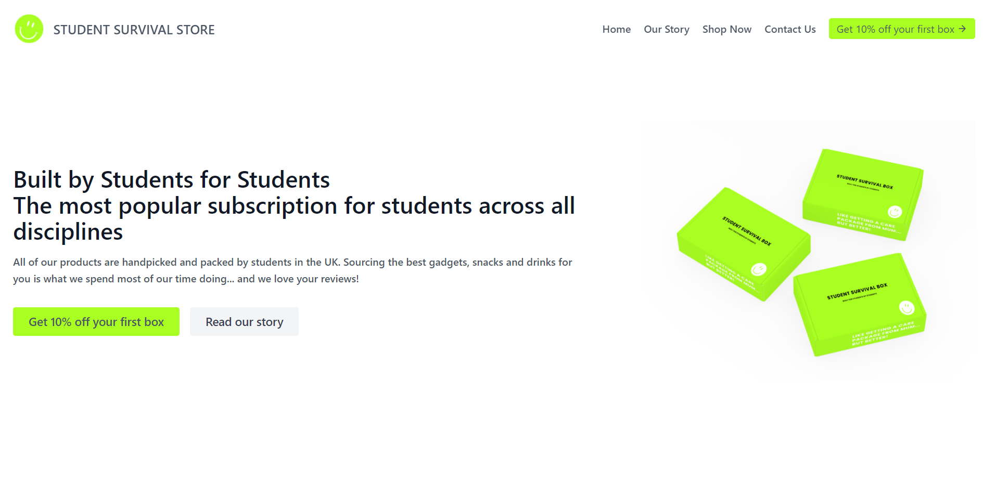

Slide 25
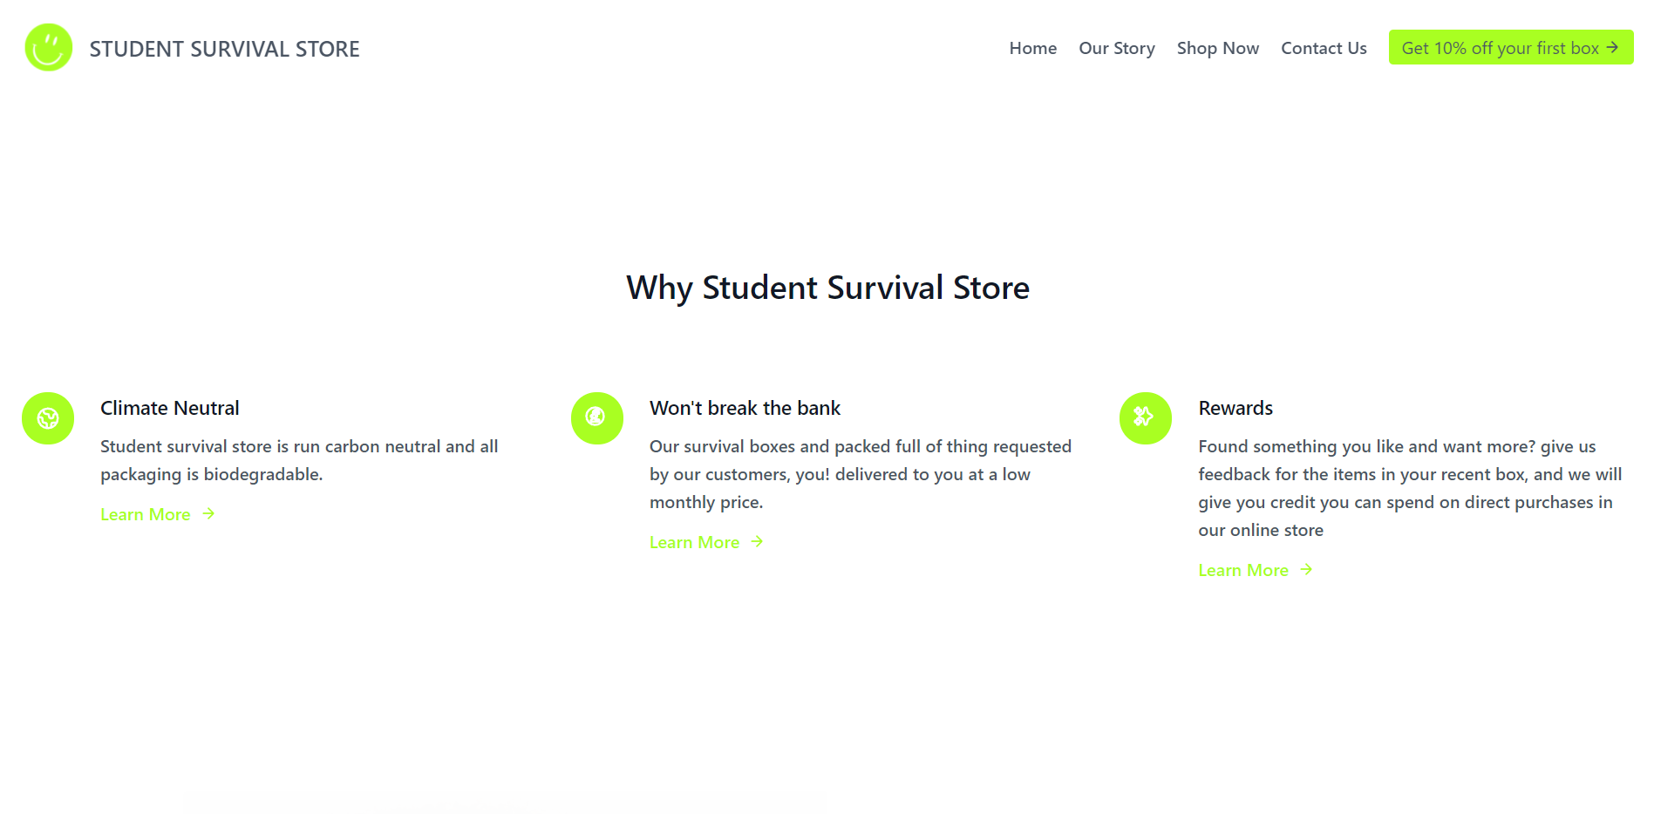

Slide 26
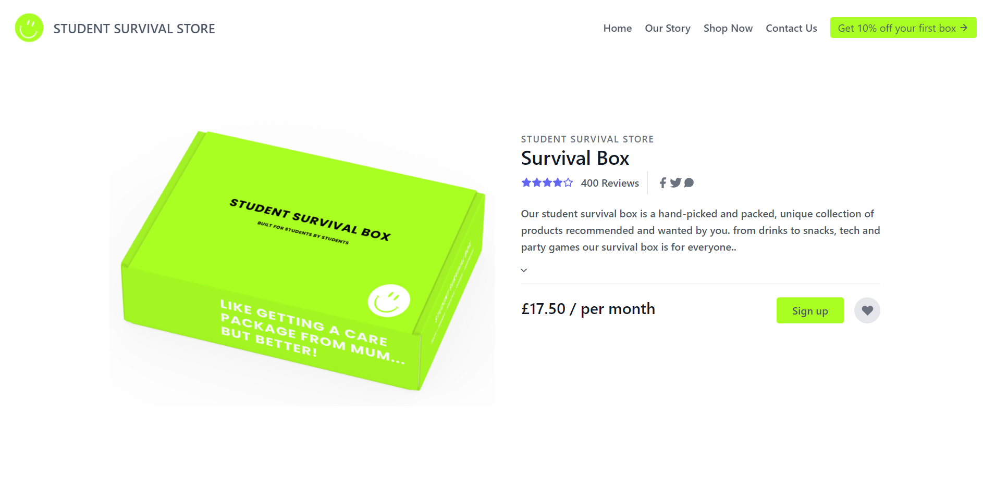

Slide 27
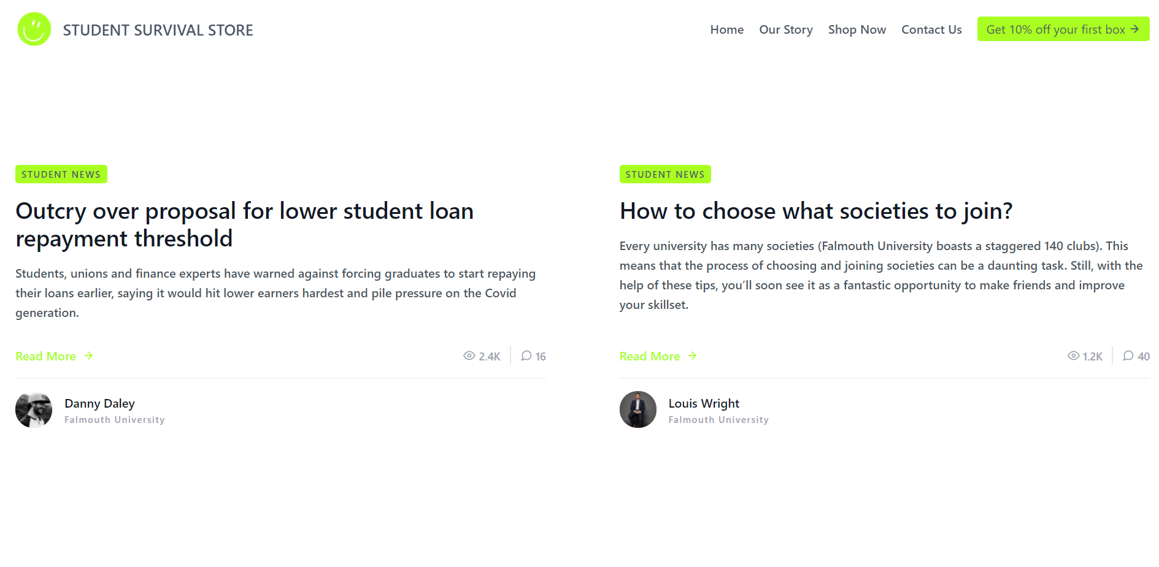

Slide 28
project
· PROJECT STAGES · PROJECT STAGES · PROJECT STAGES · PROJECT STAGES · PROJECT STAGES · PROJECT STAGES · PROJECT STAGES · PROJECT STAGES · PROJECT STAGES · PROJECT STAGES · PROJECT STAGES · PROJECT STAGES ·
5
An outline of the project in stages working within an agile methodology with MVP testing and feedback every two weeks
· PROJECT STAGES · PROJECT STAGES · PROJECT STAGES · PROJECT STAGES · PROJECT STAGES · PROJECT STAGES · PROJECT ·
· PROJECT STAGES · PROJECT STAGES · PROJECT STAGES · PROJECT STAGES · PROJECT STAGES · PROJECT STAGES · PROJECT ·
stages
· PROJECT STAGES · PROJECT STAGES · PROJECT STAGES · PROJECT STAGES · PROJECT STAGES · PROJECT STAGES · PROJECT STAGES · PROJECT STAGES · PROJECT STAGES · PROJECT STAGES · PROJECT STAGES · PROJECT STAGES ·

Slide 29
Project stages
- PROJECT STAGES -
- PROJECT STAGES -
Programming and server set up
Team Selected
Deliver final product and release
1
2
3
4
5
IDEA
START
BUILD
TESTING
LAUNCH
Wireframe and UI, UX
Focus group and feedback

Slide 30
Do you have any questions?
hello@Studentsurvivalstore.co.uk
Studentsurvivalstore.co.uk
thanks!

Slide 31
- PROJECT STAGES -
- PROJECT STAGES -
Falmouth University
Games Academy
our partners

Slide 32

Our team
- OUR TEAM -
- OUR TEAM -
Seaching for the top talent to bring this idea to fruition

Slide 33
our team
· OUR TEAM · OUR TEAM · OUR TEAM · OUR TEAM · OUR TEAM · OUR TEAM · OUR TEAM · OUR TEAM · OUR TEAM · OUR TEAM · OUR TEAM · OUR TEAM · OUR TEAM · OUR TEAM · OUR TEAM · OUR TEAM · OUR TEAM · OUR TEAM · OUR TEAM ·
Who will deliver this product to the marketplace
6
· OUR TEAM · OUR TEAM · OUR TEAM · OUR TEAM · OUR TEAM · OUR TEAM · TEAM · OUR TEAM · OUR TEAM · OUR TEAM · OUR TEAM ·
· OUR TEAM · OUR TEAM · OUR TEAM · OUR TEAM · OUR TEAM · OUR TEAM · TEAM · OUR TEAM · OUR TEAM · OUR TEAM · OUR TEAM ·
· OUR TEAM · OUR TEAM · OUR TEAM · OUR TEAM · OUR TEAM · OUR TEAM · OUR TEAM · OUR TEAM · OUR TEAM · OUR TEAM · OUR TEAM · OUR TEAM · OUR TEAM · OUR TEAM · OUR TEAM · OUR TEAM · OUR TEAM · OUR TEAM · OUR TEAM ·

Slide 34
Project Goals
- GOALS -
- GOALS -
Product description
SubBox
Feedback
Online Catalogue
A carefully selected array of products students want and need to survive
Paid brand partnerships, feedback and UGC campaigns
main products
Stocking products featured within the SubBox directly on an online catalogue so that they may be purchased if enjoyed and allow digital coins to be spent

Slide 35
Anyone who has lost track of time when using a computer knows the propensity to dream, the urge to make dreams come true and the tendency to miss lunch.
- SOMEONE FAMOUS -
- SOMEONE FAMOUS -
- creator of the internet
— Tim Berners-Lee

